Slide 1
Intelligent Resume-Based Job Suggestion and Skill-Gap Analysis System.
---------------------------------------------------------------------------------------------------------------------------------------------------------------------------------------------------
Using
AWS Bedrock, RAG Architecture, and Streamlit…..
Domain:
Artificial Intelligence | Cloud Computing | Data Engineering | NLP
Presented by . Praveen……

Slide 2
Introduction:-
Traditional job portals rely on keyword-based matching, which often:
Miss contextual meaning of skills
Ignore career progression and skill gaps
Provide generic job suggestions
This project builds an AI-driven intelligent job recommendation system that understands resumes semantically and matches them with live job postings.

Slide 3
Problem Statement:-
Traditional job portals:
Match resumes using simple keyword search
Ignore deep context of skills, experience, and education
Goal of this project:
Parse resumes automatically
Understand skills using AI & embeddings
Fetch live job data
Rank jobs intelligently
Display results dynamically in a dashboard

Slide 4
Technologies Used:-
AWS Bedrock (Claude, Titan)
AWS Lambda
AWS S3
API Gateway
MongoDB Atlas
Streamlit
RAG Architecture
NLP & Vector Search
Adzuna Job API

Slide 5
Proposed Solution:-
We propose an end-to-end AI system that:
Uses RAG (Retrieval-Augmented Generation)
Integrates AWS Bedrock LLMs
Fetches real-time job data
Performs multi-criteria ranking
Displays results via Streamlit UI

Slide 6
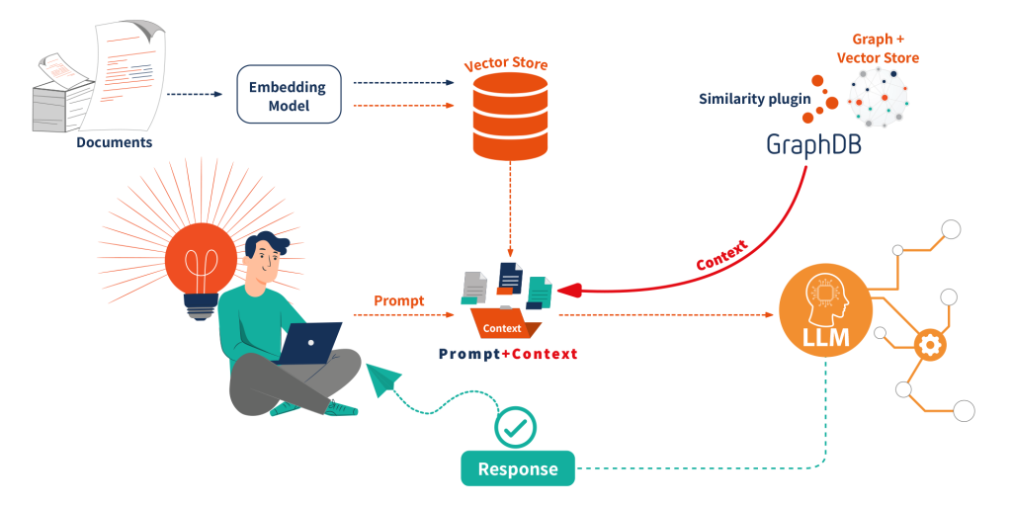
System Architecture Overview:-
High-level Components:
Streamlit (Frontend)
AWS S3 (Resume storage)
AWS Lambda (Processing & orchestration)
AWS Bedrock (Embeddings + Reasoning)
MongoDB Atlas (Vector & metadata storage)
Job APIs (Adzuna, JSearch)
API Gateway + CloudWatch

Slide 7
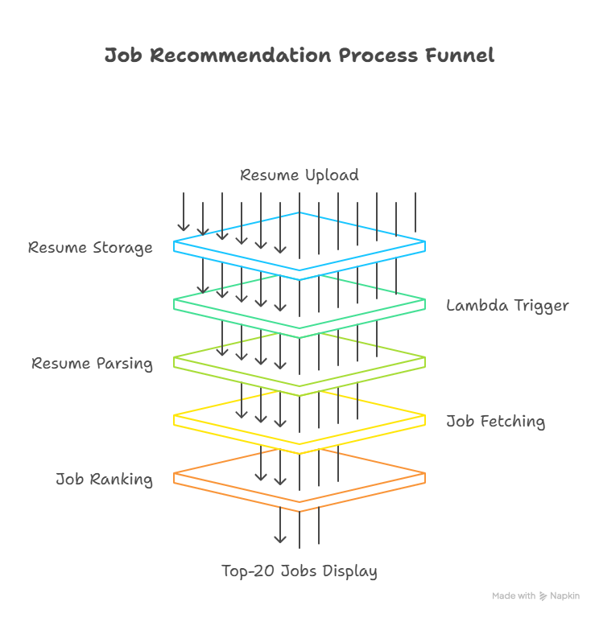
Workflow Overview:-
Resume upload via Streamlit
Resume stored in S3
Lambda triggered automatically
Resume parsed & embedded
Live jobs fetched via RAG
Jobs ranked & stored
Streamlit displays Top-20 jobs
Feedback loop improves ranking

Slide 8
Stage 1:-
Resume Upload & Pre-Processing:-
User uploads resume (PDF/DOCX)
Resume stored in AWS S3 with metadata
Validation Lambda checks file integrity
S3 event triggers processing Lambda

Slide 9
Stage 2:-
Resume Parsing & Embeddings:-
Text extracted using AWS Textract / PyPDF2
AWS Bedrock Titan Embeddings convert text → vectors
Claude LLM summarizes:
  Skills
  Education
  Experience
Stored in MongoDB:
Resume text
Skills
Education
Embedding vectors

Slide 10
Stage 3:-
RAG Job Retrieval:-
Lambda queries live job APIs (Adzuna etc.)
Job descriptions embedded using Bedrock
Vector similarity search retrieves top-k jobs
Claude LLM enriches jobs with:
  Skill requirements
  Job summaries
  Responsibilities
Stored in:
jobs_raw
jobs collections

Slide 11
Stage 4:-
Hybrid Ranking Engine:-
Each job scored using:
Final Score =
0.55 × Semantic Similarity
+ 0.25 × Skill Overlap
+ 0.10 × Recency
+ 0.10 × Popularity
Additional outputs:
Missing skill detection
“Why this job matches you” explanation
Top 20 jobs selected

Slide 12
Stage 5: Streamlit Dashboard:-
Features shown in UI:
Top 20 job recommendations
Explanation for each job
Skill-gap heatmap (pandas + matplotlib)
Recommended courses (Coursera/Udemy)
Daily refresh via API Gateway
Feedback buttons (Like / Dislike)

Slide 13
Business Use Cases & Solutions:-
USE CASE:-
Solution:-
Recruitment Automation
Career Counseling
HR Analytics
E-Learning
AI Career Assistants
AI screens resumes instantly
Personalized role suggestions
Internal talent mobility insights
Auto skill-gap → course mapping
Chatbot / Slack integration

Slide 14
Results:-
Context-aware job recommendations
AI-generated career summaries
Real-time job updates
Clear skill improvement roadmap
Interactive analytics dashboard

Slide 15
Conclusion:-
Successfully built an intelligent AI job recommendation system
Overcomes limitations of keyword-based portals
Scalable, cloud-native & modular design
Supports real-time job updates
Can be extended to:
  Chatbots
  Enterprise HR systems
  Career platforms

Slide 16
Thank you.....
.

